Slide 1
Presentation
By Diana & Josh

Slide 2
Introduction
Features of the application:
Inserting and viewing categories
Inserting and viewing products
Inserting customers
Viewing orders placed
Admin Functionality including viewing total sales for specific product, viewing all orders placed, viewing all customers

Slide 3
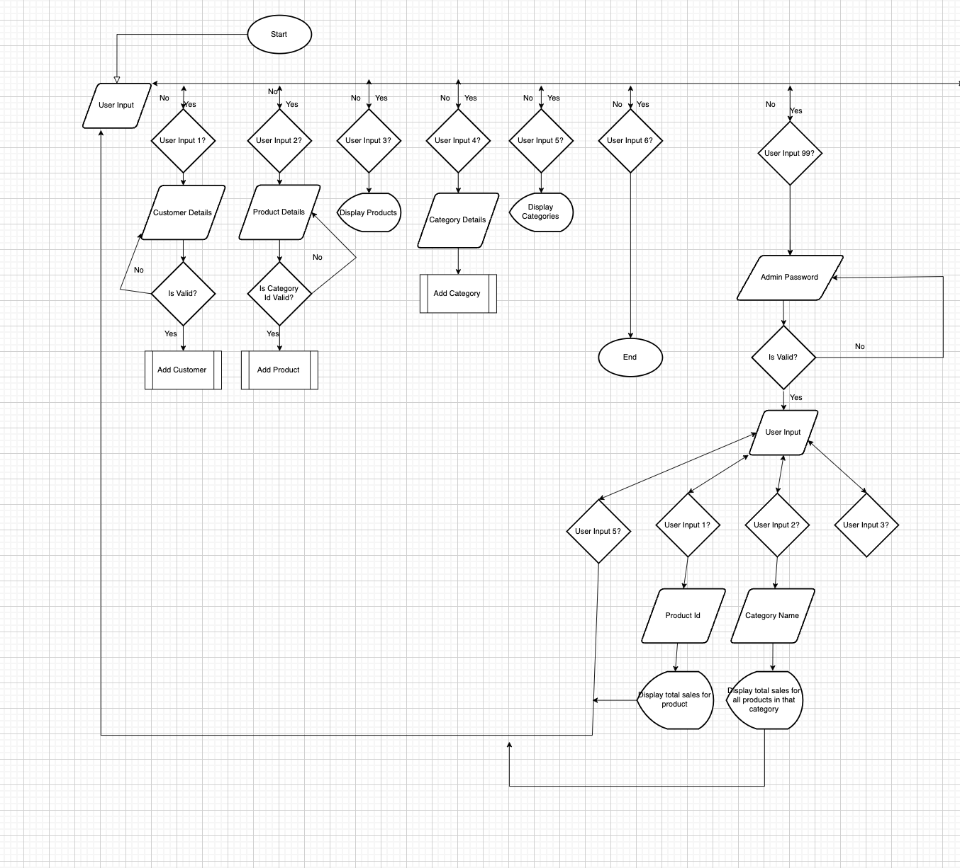
FlowChart
https://app.diagrams.net/#G1Lmw8_44ADRVbJmcJJvZr2t9gBVJm3uO7

Slide 4
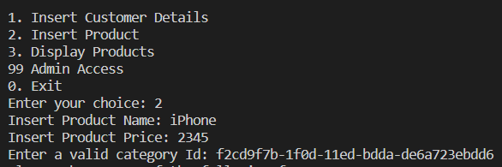
Pseudocode
START:
Display main menu:
User functions:
1. Insert customer details
2. Insert Product
3. Display Product
Admin autorisation
Admin Function:
Admin autorisation:
Admin menu:
Total sales from product ID
Total sales from category
Total sales from price range
Back to main menu
User Function

Slide 5
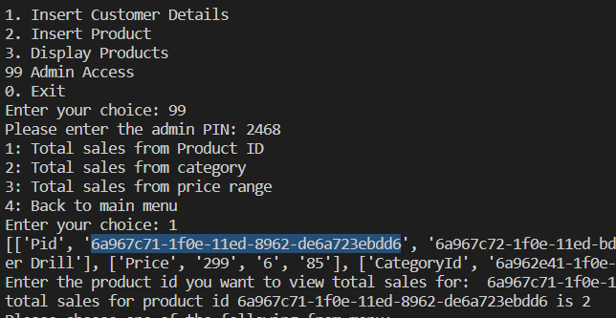
Pseudocode
Admin Function

Slide 6
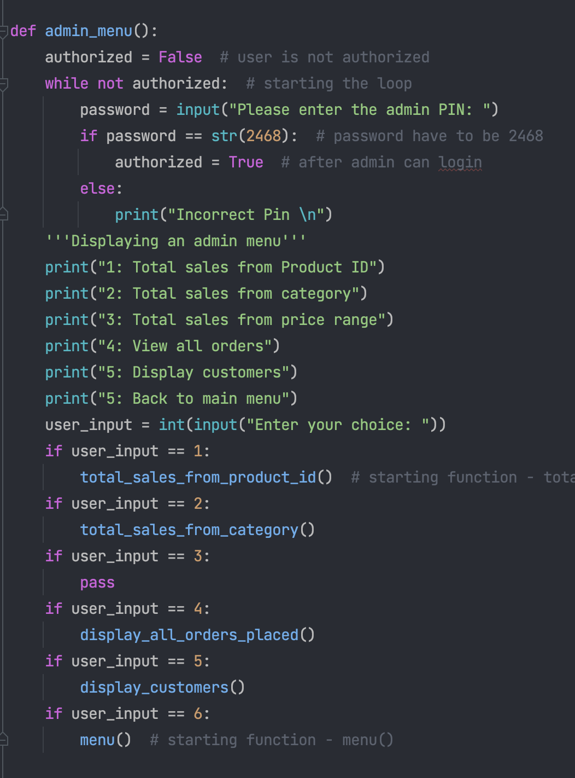
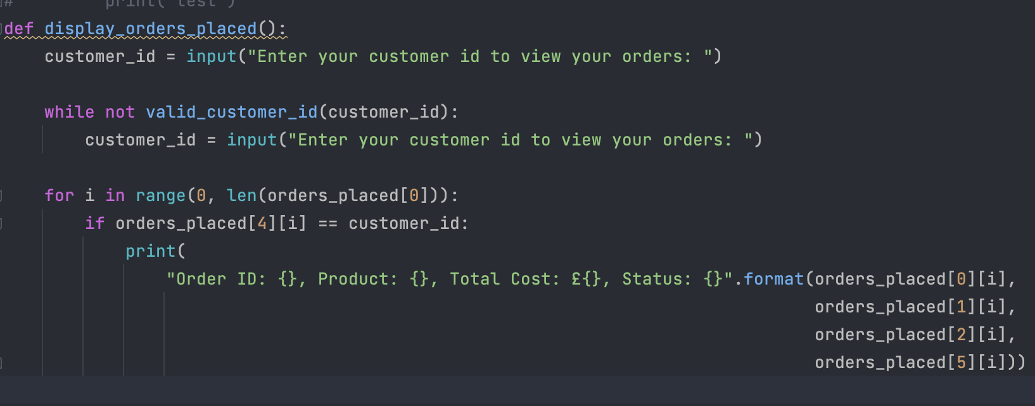
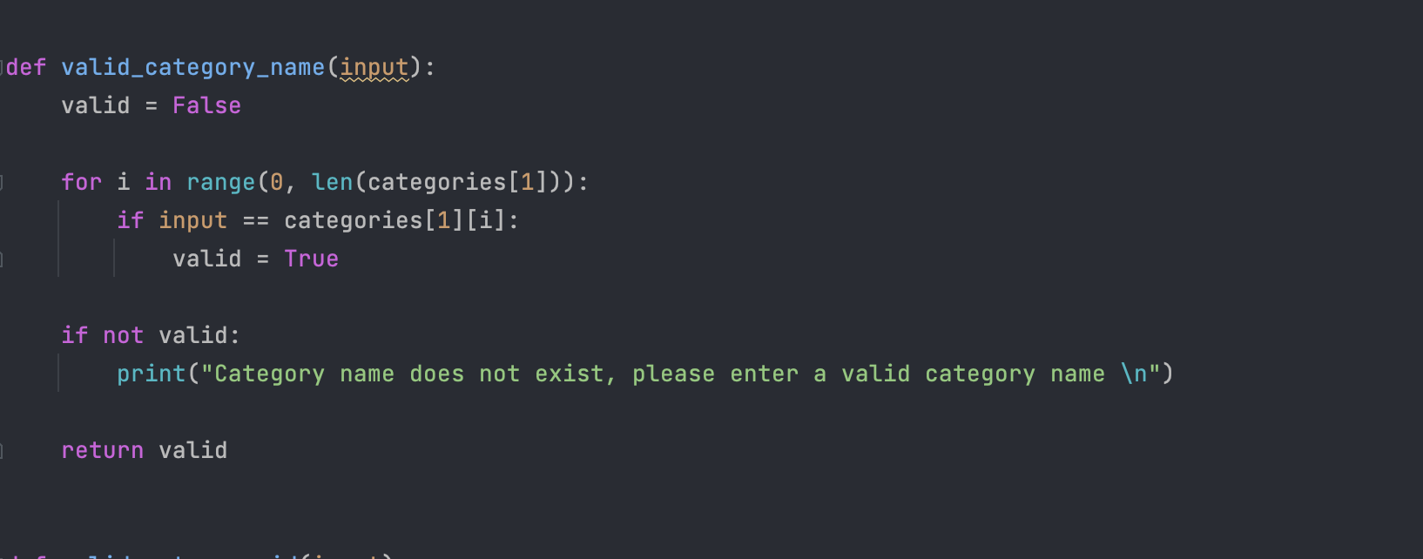
Code Snippets

Slide 7
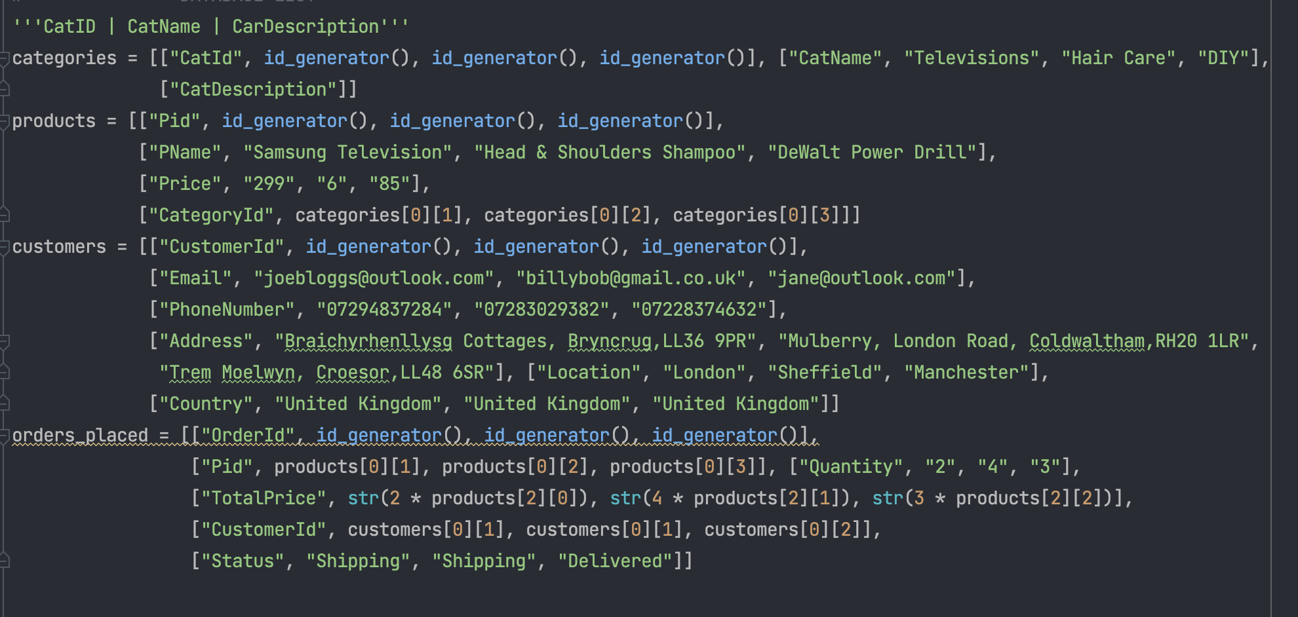
Code Snippets

Slide 8
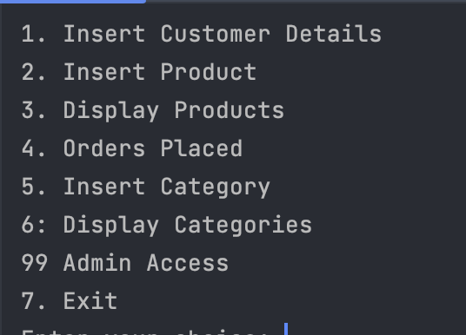
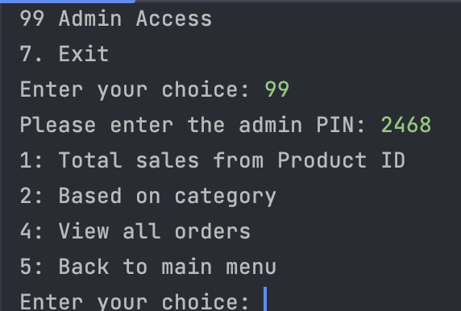
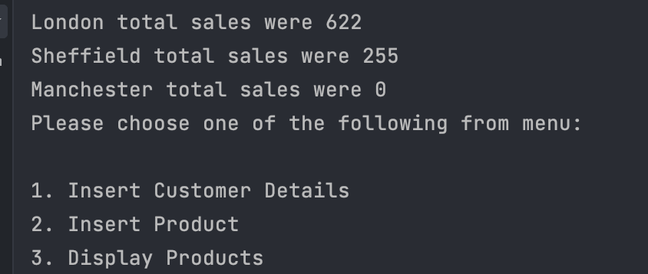
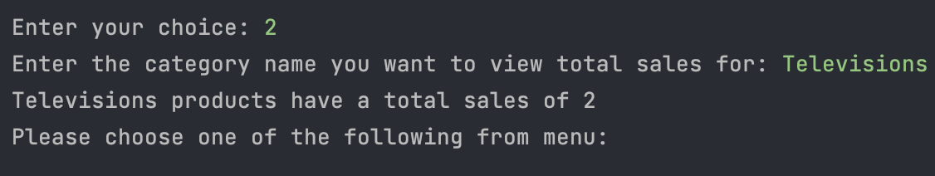
Output

